Slide 1
BUS TICKET BOOKING SYSTEM
Hemavathi Ramalingam
(176292)
03/04/2019

Slide 2
PROBLEM STATEMENT
Bus Booking System helps to save the users time by booking the ticket online.
It overcomes the traditional way of booking the tickets.

Slide 3
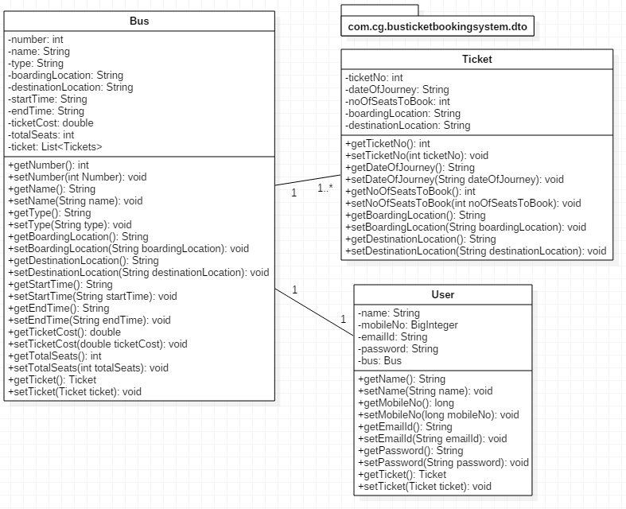
DTO CLASS

Slide 4
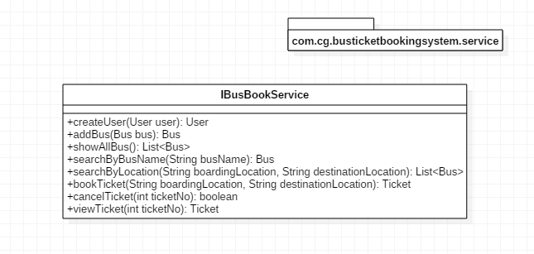
SERVICE CLASS

Slide 5
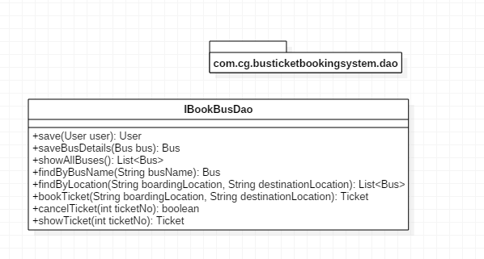
DAO CLASS

Slide 6
THANK YOU

